Slide 1

House Price Prediction Using
Machine Learning
HAYLEY , CATHERINE , NASRIN , FRANCO

Slide 2
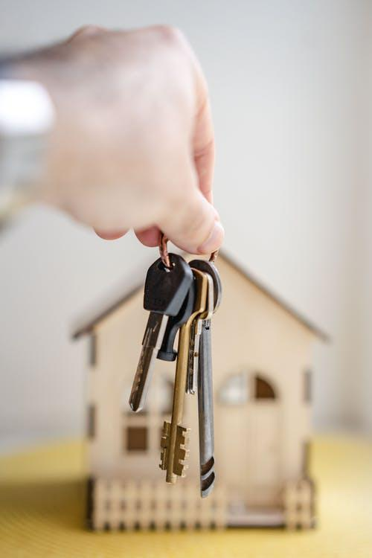
Problem Statement
HL
Housing prices are an important reflection of the economy and knowing the housing price ranges are of great interest to both buyers and sellers.
We would like to understand the relationship between different house features and how they are used to predict house price.
This is intended for home buyer / investor / seller / real estate agent.

Slide 3

Requirements
HL
Operating environment
Language - Python / JavaScript / HTML / CSS3
Server - Python / Flask
Visualisation - Tableau
User - Web Browser

Slide 4
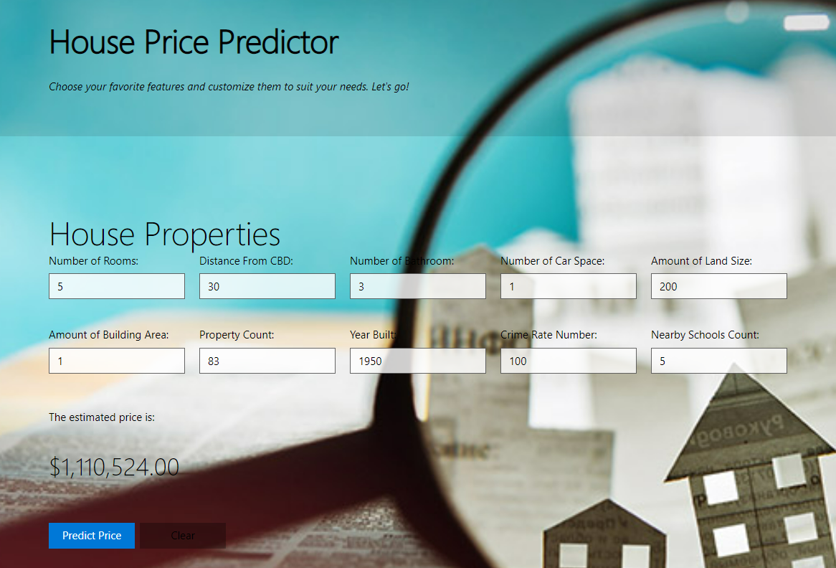
Application & Demo
We used python and flask to build the website and test the results.
We created a JSON map of features and values to allow user to choose the input.
Once they make the request, the application will receive and return a response containing the predicted price.
FH

Slide 5
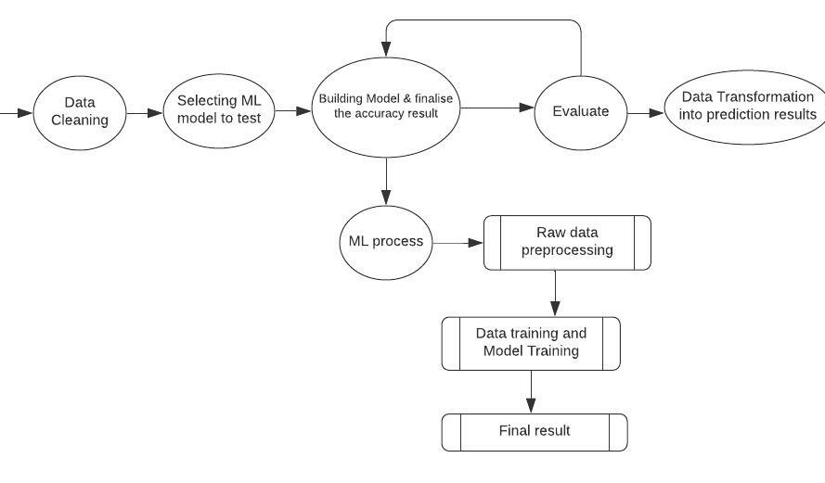
ML algorithm
NASRIN

Slide 6
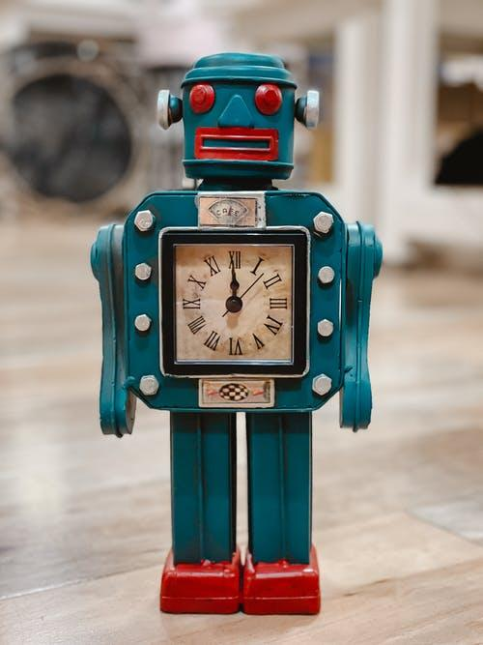

Model Comparison
NASRIN
We have tried to train a model with different methods like in the previous slides mentioned.
Logistic Regression
Random Forest
Decision Tree
Random forest regression results the highest score. thus, our work starts from there.

Slide 7

Business Objective & Problem Solving
CATH
We as data analysts are going to build a model to analyze and predict the house prices in Metropolitan Melbourne.
With 8 explanatory variables describing (almost) every aspect of residential homes in Metropolitan Melbourne, Victoria, this analysis helps to discover the impact of each feature on house pricing.
Main purpose is to predict the house prices.
Machine learning algorithm was used to estimate the price of properties with the help of historical data.
Another objective is to minimize the difference between the predicted and actual pricing.

Slide 8
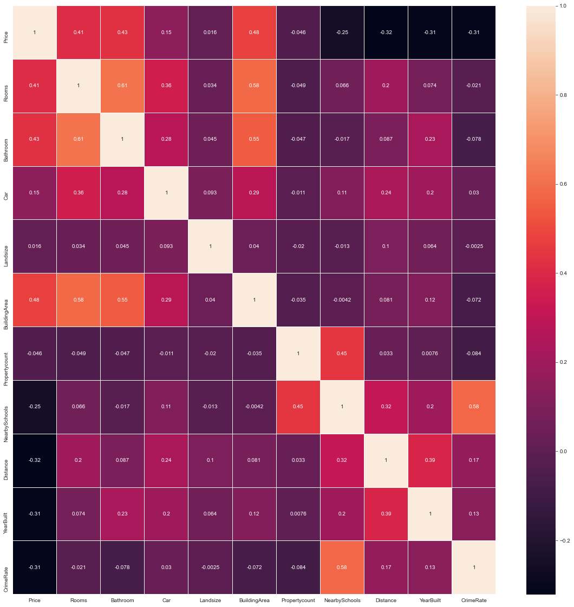
Findings
CATH
HL
Before we apply the algorithm, our hypothesis were focusing on The distance from CBD , nearby schools , crime rate, No of Rooms/ Bathrooms/ Car park
Now, our findings conclude that the main factors that have impact on house prices are:
No of rooms
No of bathrooms
No of car park
Land size
Building area

Slide 9
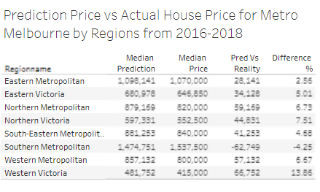
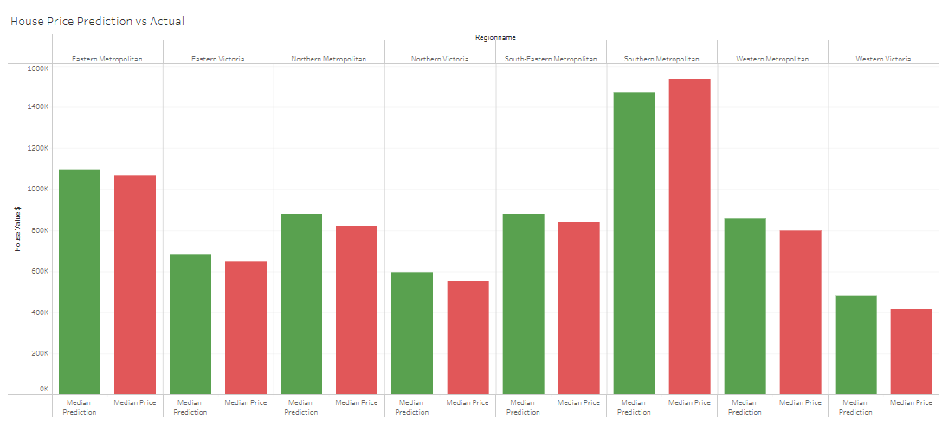
Visualize the Findings
CATH

Slide 10
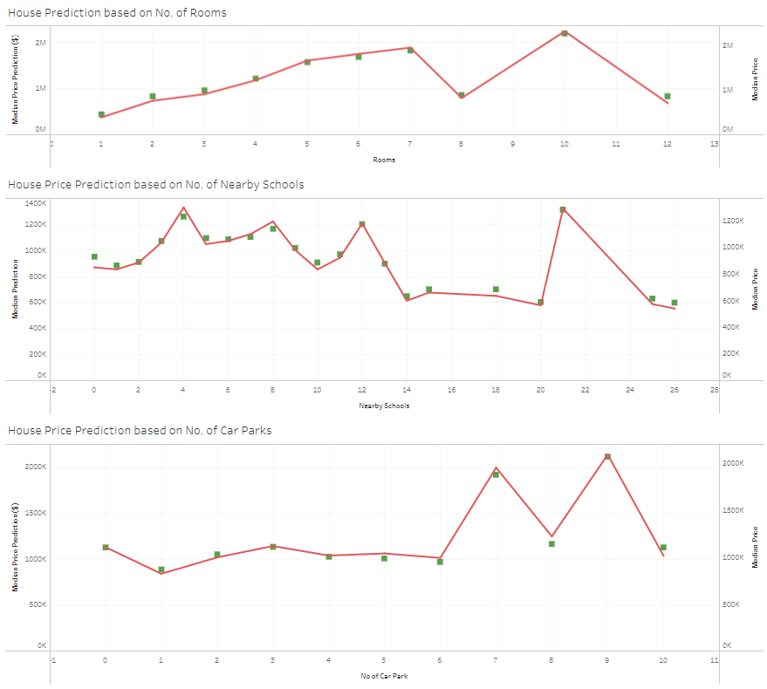
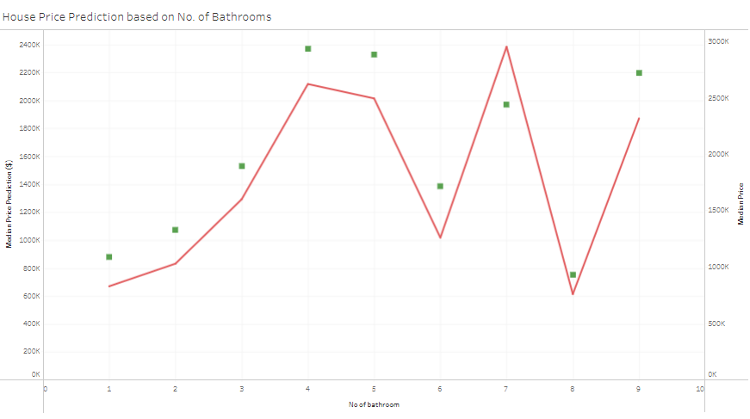

Prediction vs Actual
CATH
https://public.tableau.com/authoring/FinalProject_16428453496070/Analysis#1

Slide 11

Limitation
HL
HL
So far, the prediction is very close to the actual results, except for the prediction on bathroom features.
Our limitation is that we are not having latest data as we have limited access to public data on house prices. Our dataset includes only 2016-2018 data. Property value is considered sensitive info so we simply cannot obtain these data for free.
Out datasets is massive with multiple columns, that can also hinder us from getting higher accuracy in testing result.

Slide 12

Conclusion
HL
House Prices are growing crazily regardless of the era we are in, as fluctuation happens over time. Through this we have tried to identify the factors that are less significant. We have used the machine learning to solve this real-world problem. This solution can be tested if we have most updated data to make a better prediction.

